Slide 1
Most common deficiencies –
CAP Accreditation
CLINICAL LABORATORY IMPROVEMENT
ADVISORY COMMITTEE
Michael B. Datto MD PhD CAP Complaints and Investigations Committee Medical Director and Associate Vice President, Duke Health Clinical Laboratories Associate Professor and Vice Chair, Department of Pathology, Duke University Medical Center
November 8-9, 2023

Slide 2
Agenda
Top 10 Deficiencies: Overview
Themes:
Regulatory
Workforce
Technology
Recommendations

Slide 3
Top 10 Deficiencies: Overview*
GEN.55500 Competency Assessment Elements - Nonwaived Testing
COM.04250 Comparability of Instruments and Methods - Nonwaived Testing
COM.01200 Activity Menu
COM.10000 Policy and Procedure Manual
COM.01700 PT and Alternative Performance Assessment Result Evaluation
COM.30600 Maintenance/Function Checks
COM.04200 Instrument/Equipment Record Review
COM.01400 PT Attestation Statement
COM.30750 Temperature Checks
GEN.20450 Correction of Laboratory Records
*Please see addendum “Accreditation 2022 Top 10 Deficiencies” for more information

Slide 4
Top 10 Deficiencies: Root Causes*
Common reasons for citations across top 10 deficiencies:
Missing records for activities to be performed at defined frequencies (eg, daily, weekly, monthly, twice a year, annually)
Not following (equipment) manufacturer’s defined frequency for maintenance /verification or written procedures
Inadequate records of supervisory oversight (eg, competency, PT, maintenance)
Lack of understanding of complex requirements
Root Causes
Regulatory Documentation Requirements Are Complex
Workforce Shortages and Inexperienced Staff (Staff turnover)
Manual Processes (Lack of Technology Solutions)

Slide 5
Regulatory
Regulatory Documentation Requirements demand a significant amount of laboratory employee time.
Documentation and recordkeeping must be done by laboratory personnel often pulling them away from ‘the bench’
Regulations are complex and can be difficult to comply with all required aspects
Competency assessment is a prime example.

Slide 6
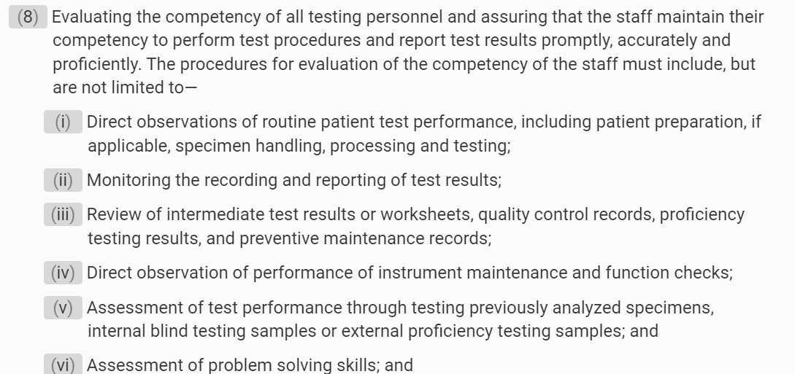
Regulatory
At least Semiannually during the first year and yearly thereafter (unless methodologies change), each employee must be evaluated for competency.
https://www.ecfr.gov/current/title-42/chapter-IV/subchapter-G/part-493

Slide 7
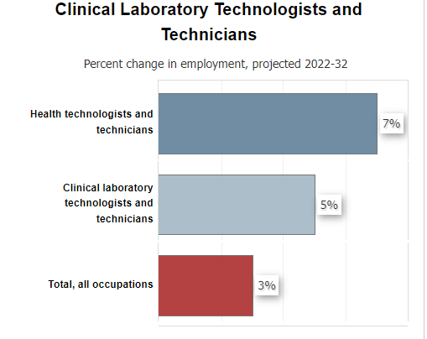
Workforce
Limited laboratory workforce means that personnel and supervisors must focus their time on patient-facing work at the expense of record-keeping and administration
In 2022 there were only 342,900 Clinical Laboratory Technologists and Technicians in the US (typically Bachelors, average $27.59/hour).
In 2014 there were 335,721 (1.5% growth over 8 years)
Currently there are about 24,000 unfilled positions.
https://www.bls.gov/ooh/healthcare/clinical-laboratory-technologists-and-technicians.htm
Notes:
Personnel shortages cause supervisory personnel to need to work the bench and spend less time on their supervisory duties.
Newer personnel require a higher level of oversight.
Personnel qualifications are complicated because the names of the degrees don’t always match up with the regulations, different types of records may be provided (degrees, transcripts, primary source verification, foreign equivalency records). This often makes hiring decisions confusing.

Slide 8
Technology
Technology, including In-Vitro Diagnostic (IVD) and Health Information Technology (HIT) can be used to save laboratory workers’ time.
Paper documentation and paper-based workflows for reporting, inventory management, sample tracking, training, competency, etc. remain a common practice in many laboratories.
CMS requires paper-based submission in certain settings.
Transitions from paper documentation to electronic systems carries significant up-front costs with hard to realize longer term savings.

Slide 9
Initiatives and Recommendations
Regulatory:
CAP continues to make tools available to laboratories to standardize documentation for things like competency assessments, new test validations, personnel requirements. By standardizing the way labs document, we can standardize the practice itself.
We recommend that CLIA/CMS do the same
Simplify and provide clarification, examples, and FAQs for compliance with complex regulatory requirements including those listed as common deficiencies in this presentation.
Support the development of tools that can automate or standardize documentation and record keeping for common deficiencies including competency assessments, personnel records.
Evaluate the impact of how we define a laboratory on compliance with current regulations.
Allow competency assessment to be transferable
PT for the distributive testing model (NGS)

Slide 10
Recommendations
Workforce:
CAP:
Serves as a resource for CAP laboratories to evaluate personnel qualifications
Advocates for policies and programs at federal level to make medical technologist an attractive career: e.g., loan forgiveness, creation of community college pipelines
We recommend that CMS/CLIA:
Continue to allow flexibility in remote work for the review of images and data.
Clearly define ‘testing’, the components of work that go into producing a test result, and qualifications required to perform these components. This may broaden the scope of those able to work in laboratory medicine, e.g.: Is loading a highly complex instrument high complexity testing?
Allow general supervisors to perform competency assessments of moderate- and high-complexity personnel
Create clear qualification algorithms for testing personnel based on their education instead of specific degrees

Slide 11
Recommendations
Technology:
CAP has created templates and processes to streamline laboratory information exchange
Direct Transmission of Proficiency Testing (PT) results
Online systems for deficiency response and proficiency testing compliance follow-up
Electronic cancer protocols
We recommend that CMS/CLIA
Develop automated electronic reporting processes whenever compliance documentation is required to remove burden from staff.
Convene a tri-agency group (CMS, FDA, ONC) to identify technology-driven solutions to streamline documentation and automate reporting within regulated devices and HIT systems

Slide 12
Questions? Michael B. Datto MD PhD michael.datto@duke.edu

