Slide 1
Final 2024 Medicare Policy and Payment Changes for Pathologists
A. Joe Saad, MD, CPE, FCAP
Ronald McLawhon, MD, PhD, FCAP
Gregary Bocsi, DO, FCAP
Pamela K. Wright, Senior Director of CAP Economic & Regulatory Affairs, Advocacy
November 30, 2023
Notes:
Pam Wright:
Good day and welcome to the C-A-P webinar, “The 2024 Medicare Policy and Payment Changes for Pathologists.” I am Pam Wright, the Senior Director of Economic and Regulatory Affairs at the C-A-P. During the next hour, we will discuss the regulations and policies for the Medicare Physician Fee Schedule and Quality Payment Program that will be used to reimburse pathology services in 2024.
Before we get started, I would like to review a couple of technical details about today’s presentation and introduce our presenters. To the right of the presentation slides is the GoToWebinar control panel, where you can type in your questions during the presentation. There will be time at the end of the presentation for our panelists to address them. We will select questions that are a representative sample of those submitted during our limited time today.
An archived recording of the webinar will be available later next week through GoToMeeting. The C-A-P will have a link to this presentation, along with a PDF of the slide deck in webinar section of the C-A-P.org website.
Let me now take a moment to review our agenda and introduce our presenters …
[Next Slide]

Slide 2
Welcome
A. Joe Saad, MD, CPE, FCAP
Chair, CAP Council on Government and Professional Affairs
Notes:
Pam Wright: Our first presenter is Dr. A. Joe Saad, Chair of the C-A-P’s Council on Government and Professional Affairs. Dr. Saad is also a member of the C-A-P Board of Governors, chief of pathology for the Methodist Health System in Dallas and adjunct associate professor of pathology at the University of Texas Southwestern Medical Center.
[Next Slide]

Slide 3
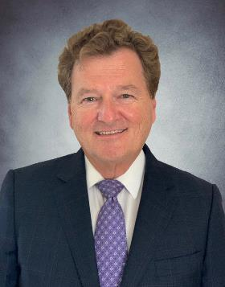
Welcome
Ronald McLawhon, MD, PhD, FCAP
Chair, CAP Economic Affairs Committee
Notes:
Pam Wright: Our second presenter is Dr. Ronald McLawhon who is the chair of the C-A-P’s Economic Affairs Committee and a member of the Council on Government and Professional Affairs. Dr. McLawhon is also professor and Vice Chair of pathology and director of clinical laboratory at University of California, San Diego.
[Next Slide]

Slide 4
Welcome
Gregary Bocsi, DO, FCAP
Chair, CAP Quality and Clinical Data Registry Committee
Notes:
Pam Wright: And our final presenter is Dr. Gregary Bocsi. Dr. Bocsi is the Chair of the C-A-P’s Quality and Clinical Data Registry Committee. Dr. Bocsi is an Associate Professor of Pathology at the University of Colorado School of Medicine.
And now it is my pleasure to turn the presentation over to Dr. Saad.
[Next Slide]

Slide 5
Agenda
Overview of Payment Policy and Advocacy
Final 2024 Fee Schedule Changes
Pathology Codes Impact and Outlook for 2024
Proposed 2024 Quality Payment Program Policy Overview
Questions
Notes:
Dr. Saad: Thank you Ms. Wright. During this informative webinar, we will briefly review the C-A-P’s Policy and Advocacy Agenda, thoroughly review the changes to 2024 physician fee schedule and the quality payment program, and how they will affect the practice of pathology. And of course, we will take questions.
[Next Slide]

Slide 6
Final 2024 Medicare Physician Fee Schedule and Quality Payment Program Regulations
Final 2024 Medicare Physician Fee Schedule and Quality Payment Program regulations were released on November 2, 2023
CAP members received a Special Advocacy Update with initial analysis of this regulation
CAP will continue to engage with the Centers for Medicare & Medicaid Services (CMS)
Final regulations implemented January 1, 2024
Notes:
Dr. Saad: I am happy to moderate our informative review of the 2024 Medicare Policy and Payment Changes for Pathologists webinar.
We hope that you all received the special Advocacy Update on November 2nd. Today we will go into more detail about the C-A-P’s findings.
[Next Slide]

Slide 7
Stopping Medicare Cuts
CAP, AMA, and other physician specialties are pushing hard for Congress to now fix Medicare cuts.
In 2022, lawmakers mitigated Medicare cuts by increasing pay 1.25% in 2024.
However, pathologists will still face about 2.75% cut despite the increase.
Final Medicare fee schedule shows the impact of the cut.
Notes:
Dr. Saad

Slide 8
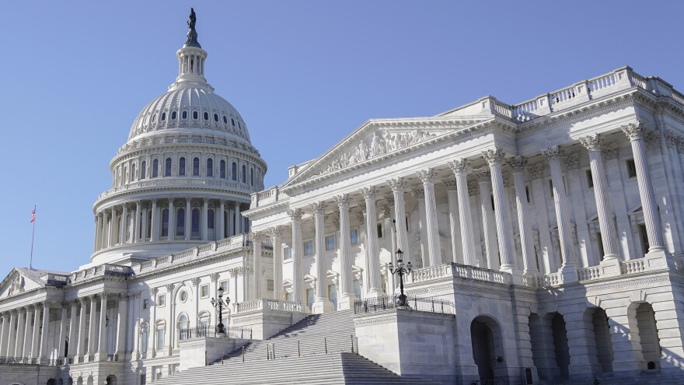
Advocacy In Action Against Medicare Cuts
Year-long effort by the CAP to stop Medicare cuts to pathologists:
Hill Day in April: CAP members met with 145 congressional offices.
September grassroots push: 1,700 messages sent by CAP members to Congress.
October ‘fly-in’: Successful meetings with 60 congressional offices.
Published op-ed and letters to the editor in key congressional districts urging Congress to act!
Notes:
Dr. Saad

Slide 9
Support for Saving Access to Laboratory Services Act (SALSA)
CAP strongly supports passage of SALSA.
Mitigate Medicare cuts to clinical lab services of up to 15%.
Reform Medicare statute requiring accurate data collection to set future rates for lab fees.
Creates a sustainable path for labs going forward.
Congress has delayed 2024 cuts by one year. Buys more time to permanently address these cuts.
Notes:
Dr. Saad:

Slide 10
Physician Practice Information (PPI) Survey Launch Date July 31, 2023
The CMS is updating practice expense per hour data to calculate payment for physician services
AMA-led effort focuses on indirect practice expense cost data
These data are key to future updates in Medicare pay formula used to reimburse pathologists
Be on the lookout for an email with the subject line “American Medical Association requests your input on physician practice expense and patient care hours"
Invitations and reminders about the PPI survey to financial experts at a practices will come from: PPISurvey@mathematica-mpr.com.
Invitations and reminders about the physician hours survey to physicians will come from PhysicianHoursSurvey@mathematica-mpr.com or from the practice directly.
Notes:
Dr. Saad
The CMS wants updated practice expense per hour data for use in its payment calculations for physician services
AMA leading effort to collect data focusing on updating indirect practice expense cost data
These data are key to future updates in the formula used to reimburse pathologists for indirect practice expense costs with greatest impact on the technical and global payment
Email subject line “American Medical Association requests your input on physician practice expense and patient care hours"
Invitations and reminders about the PPI Survey, sent financial experts in the practice, will come from PPISurvey@mathematica-mpr.com. Invitations and reminders about the Physician Hours Survey, distributed to physicians, will come from PhysicianHoursSurvey@mathematica-mpr.com or from the practice directly.

Slide 11
Independent Laboratory Clinician Practice Information (CPI) Survey Launch Date January 2024
The CMS is updating practice expense per hour data to calculate payment for services paid on the physician fee schedule
Focuses on indirect practice expense cost data
These data are key to future updates in Medicare pay formula
Be on the lookout for an email with the subject line “The College of American Pathologists requests your input to update Medicare clinician payment"
Invitations and reminders about the survey to practices will come from: CPISurvey@mathematica-mpr.com.
Notes:
Dr. Saad
The CMS wants updated practice expense per hour data for use in its payment calculations for physician services
The CAP is leading effort to collect data focusing on updating indirect practice expense cost data
CAP members are encouraged to participate in the Clinician Practice Information Survey
The Clinician Practice Information (CPI) Survey, a partner survey to the Physician Information Survey (PPI) is underway, and selected CAP members are encouraged to engage in this effort.
These data are key to future updates in the formula used to reimburse pathologists for indirect practice expense costs with greatest impact on the technical and global payment
Email subject line “The College of American Pathologists requests your input to update Medicare clinician payment"
Invitations and reminders about the CPI Survey, sent financial experts in the practice, will come from CPISurvey@mathematica-mpr.com.

Slide 12
Final 2024 Medicare Physician Fee Schedule
Notes:
Dr. Saad turns the program over to Dr. Mclawhon

Slide 13
CAP Win: Restored Rank Order for Cytotechnologists
The CMS is in the third year of the clinical labor rate update
Pathology continues to benefit from an increase to the histotechnologist clinical labor rate that CAP successfully advocated for in 2022
As a result of additional CAP advocacy this year, the CMS announced a positive change (+12%) to the cytotechnologist clinical labor rate within CMS' practice expense RVU calculations, which impacts pathology technical and global component services
These increases offset reductions from budget neutrality adjustments that decrease the conversion factor
The CAP estimates the full impact of all our pathology related clinical labor advocacy on Medicare payment is approximately $17 million per year over the next two years
Notes:
Dr. McLawhon:

Slide 14
Impact of Cytotechnologist Clinical Labor Rate Update
CPT Code | Modifier | Description | Percent Increase in Total RVU
88112 | Global | Cell examination of specimen | 1.00%
88112 | TC | Cell examination of specimen | 1.60%
88173 | Global | Evaluation of fine needle aspirate with interpretation and report | 2.40%
88173 | TC | Evaluation of fine needle aspirate with interpretation and report | 4.20%
88184 | Global | Flow cytometry, cell surface, cytoplasmic, or nuclear marker, technical component only; first marker | 3.10%
88185 | Global | Flow cytometry, cell surface, cytoplasmic, or nuclear marker, technical component only; each additional marker (list separately in addition to code for first marker) | 1.40%
88381 | Global | Microdissection; manual | 2.00%
88381 | TC | Microdissection; manual | 2.30%
Expected increase to pathology and independent laboratories in 2024 is $1.5 million, with an additional $1.5 million in 2025
Notes:
This is a snapshot of the higher volume codes impacted. The mostly impacts cytopathology and flow cytometry services.

Slide 15
CMS Implements Evaluation and Management Add-on Code G2211 and Other E/M Services
Despite ongoing opposition and advocacy by the CAP, the AMA RUC, and other medical societies and associations, CMS finalized the Evaluation and Management (E/M) Level II HCPCS add-on code G2211, with large budget neutrality adjustments that negatively affect pathologists and other medical specialties throughout the physician fee schedule
While CMS adopted the AMA RUC recommendations for the revised office/outpatient visit E/M CPT codes in 2021, it noted that these “values did not fully account for the resource costs associated with primary care and other longitudinal care of complex patients” and first proposed the creation of G2211
G2211 Visit complexity inherent to evaluation and management associated with medical care services that serve as the continuing focal point for all needed health care services and/or with medical care services that are part of ongoing care related to a patient's single, serious condition or a complex condition. (Add-on code, list separately in addition to office/outpatient evaluation and management visit, new or established)
Notes:
Dr. McLawhon:
CMS adopted the AMA RUC recommendations for the revised office/outpatient E/M CPT visit codes, however CMS believes those “values did not fully account for the resource costs associated with primary care and other longitudinal care of complex patients.”

Slide 16
Impact of E/M Add-on Code G2211 and other E/M Services in 2024
Per CMS, the primary policy goal of G2211 is to increase payments to primary care physicians and to reimburse them more appropriately for the care provided to serious condition or complex patients.
G2211 can be reported in conjunction with all office/outpatient E/M visits levels (i.e., CPT 99202-99515)
2024 Payment for G2211 is $16.04
Given the extremely high utilization estimates (38% initially, and 54% when full adopted), G2211 will have a significant effect upon budget neutrality and the conversion factor.
In 2024 alone, the estimated increase in spending will be $1.34 billion, resulting a corresponding 2.0% cut to the conversion factor
The CAP, the AMA, and other stakeholders will continue to advocate against the implementation of G2211 through public comment and by supporting for legislative action
Notes:
Dr. McLawhon

Slide 17
Overall Pathology Payment Changes for 2024
The conversion factor for the 2024 fee schedule payment formula is decreased by 3.37% relative to that of the 2023 fee schedule
• The decrease in the conversion factor is primarily due to:
o Implementation of the E/M add-on code G2211, (responsible for 2%)
1.25% net reduction of the Consolidated Appropriations Act, 2023
As a result of these changes, the CAP estimates:
-2.72% overall impact to pathology Medicare payments
-1.61% overall impact to independent laboratory Medicare payments
Review the pathology services changes in our Final 2024 Medicare Physician Fee Schedule Impact Table.
Notes:
Dr. McLawhon
The decrease in the conversion factor is a result of a reduction in the temporary update to the conversion factor under current law and a negative budget neutrality adjustment stemming in large part from the adoption of an office visit add-on code

Slide 18
Top Pathology Services – Reimbursements
CPT Code | Modifier | Short Descriptor | 2023 Payment | 2024 Payment | Percent Change
88305 | 26 | Tissue exam by pathologist | $36.60 | $35.36 | -3%
88307 | 26 | Tissue exam by pathologist | $80.99 | .$77.60 | -4%
88312 | 26 | Special stains group1 | $26.09 | $25.21 | -3%
88313 | 26 | Special stains group 2 | $11.86 | $11.46 | -3%
88341 | 26 | Immunohisto antb addl slide | $27.79 | $26.52 | -5%
88342 | 26 | Immunohisto antb 1st stain | $34.23 | $33.07 | -3%
88305 | Global | Tissue exam by pathologist | $71.84 | $70.40 | -2%
88307 | Global | Tissue exam by pathologist | $292.79 | $282.91 | -3%
88312 | Global | Special stains group1 | $113.52 | $110.68 | -3%
88313 | Global | Special stains group 2 | $82.69 | $81.53 | -1%
88341 | Global | Immunohisto antb addl slide | $87.09 | $89.40 | 3%
88342 | Global | Immunohisto antb 1st stain | $100.98 | $104.14 | 3%
88305 | TC | Tissue exam by pathologist | $35.24 | $35.04 | -1%
88307 | TC | Tissue exam by pathologist | $211.80 | $205.31 | -3%
88312 | TC | Special stains group 1 | $87.43 | $85.46 | -2%
88313 | TC | Special stains group 2 | $70.82 | $70.07 | -1%
88341 | TC | Immunohisto antb addl slide | $59.30 | $62.54 | 5%
88342 | TC | Immunohisto antb 1st stain | $66.76 | $71.05 | 6%
Notes:
Dr. Mclawhon

Slide 19
Largest Changes in Pathology Payments – 2024
CPT Code | Modifier | Short Descriptor | 2023 Payment | 2024 Payment | Percent Change
36514 | Global | Apheresis plasma | $571.34 | $652.92 | 14%
88104 | TC | Cytopath fl nongyn smears | $43.04 | $48.13 | 12%
88162 | TC | Cytopath smear other source | $81.33 | $89.06 | 10%
88160 | TC | Cytopath smear other source | $50.49 | $54.03 | 7%
88161 | TC | Cytopath smear other source | $52.53 | $55.99 | 7%
88104 | Global | Cytopath fl nongyn smears | $69.81 | $74.33 | 7%
88355 | TC | M/phmtrc alys skeletal musc | $61.34 | $51.74 | -16%
88355 | Global | M/phmtrc alys skeletal musc | $141.99 | $124.10 | -13%
88355 | 26 | M/phmtrc alys skeletal musc | $80.65 | $72.36 | -10%
88374 | TC | M/phmtrc alys ishquant/semiq | $264.32 | $242.63 | -8%
88374 | Global | M/phmtrc alys ishquant/semiq | $306.34 | $282.58 | -8%
88387 | TC | Tiss exam molecular study | $7.79 | $7.20 | -8%
Notes:
CPT codes 88355 and 88374 decreased not due to any change to the physician work or practice expense inputs. Rather the change is a result of the nature of CMS's practice expense methodology. We are reviewing these decreases carefully and will follow up with CMS on both.

Slide 20
CAP Win: More Digital Pathology CPT Codes for 2024
The CAP successfully advocated for the inclusion of 30 additional new Category III CPT digital pathology codes for 2024
The CAP worked with the American Medical Association (AMA) CPT Editorial Panel to develop 30 new digital pathology add-on codes
This is in addition to the 13 digital pathology add-on codes established for 2023
The codes are used to report additional clinical staff work and service requirements associated with digitizing glass microscope slides for primary diagnosis
The codes help pathologists, pathology practices, and laboratories providing digital pathology digitization procedures appropriately report these services
Notes:
Dr. McLawhon

Slide 21
Digital Pathology CPT Codes
Histopathology
88321 +0838T
88323 +0839T
88325 +0840T
88331 +0841T
88332 +0842T
88346 +0845T
88350 +0846T
88363 +0847T
88365 +0848T
88364 +0849T
88366 +0850T
88368 +0851T
88369 +0852T
88377 +0853T
88348 +0856T
Cytopathology
88104 +0827T
88106 +0828T
88108 +0829T
88112 +0830T
88141 +0831T
88160 +0832T
88161 +0833T
88162 +0834T
88172 +0835T
88177 +0836T
88173 +0837T
88333 +0843T
88334 +0844T
Hematopathology
85060 +0854T
85097 +0855T
Notes:
Dr. McLawhon

Slide 22
Digital Pathology Digitization Procedures
Digital pathology is a dynamic, image-based environment that enables the acquisition, management, and interpretation of pathology information generated from digitized glass microscope slides.
►Glass microscope slides are scanned by clinical staff, and captured whole-slide images (either in real-time or stored in a computer server or cloud-based digital image archival and communication system) are used for digital examination for pathologic diagnosis distinct from direct visualization through a microscope. Static digital photographic and photomicrographic imaging or digital video streaming of any portion of a glass microscope slide on mobile smartphone and tablet devices does not constitute a digital pathology digitization procedure.
Notes:
Dr. McLawhon
[Next slide]

Slide 23
Digital Pathology Digitization Procedures
Digitization of glass microscope slides enables remote examination by the pathologist and/or in conjunction with the use of artificial intelligence (AI) algorithms. Category III add-on codes 0751T-0763T, 0827T-0856T may be reported in addition to the appropriate Category I service code when the digitization procedure of glass microscope slides is performed and reported in conjunction with the Category I code for the primary service. Each Category III add-on code is reported as a one-to-one unit of service for each primary pathology service code.◄
Notes:
Dr. Mclawhon
[Next slide]

Slide 24
Digital Pathology Digitization Procedures
June 30, 2023: Released to the AMA website
July 2023 - December 2023: Implementation Period
Effective Date: January 1, 2024
Notes:
Dr. McLawhon
[Next slide]

Slide 25
Final 2024 Medicare Quality Payment Program Requirements
Notes:
Dr. McLawhon: Now I will turn it over to Dr. Bocsi who review the finalized changes to the Quality Payment Program and MIPS requirements for 2024.
Dr. Bocsi: Thank you Dr. McLawhon.
[Next slide]

Slide 26
Quality Payment Program Pathways
The Quality Payment Program is increasingly complex and pathology practices need to make strategic decisions on how to participate in it:
QPP
MIPS
APMs
Traditional MIPS
MIPS Value Pathways
MIPS APMs
MIPS Value Pathways (MVPs) are new in 2023 and do not include pathologists in 2023 or 2024
Notes:
Dr. Bocsi: As a refresher, there have been two pathways offered under the QPP: MIPS and APMs. MIPS is the pathway for clinicians under the QPP unless a physician qualifies as a participant in an Advanced Alternative Payment Model.
As we have shared before, CMS has stated that they want all beneficiaries in an “accountable care relationship” (that is, all physicians in value-based payment arrangements) by 2030. Indeed, CMS would ideally like to see traditional MIPS go away in favor of advanced alternative payment models. However, that is not realistic right now. In the interim, CMS has introduced a new “transition” pathway between MIPS and APMs called MIPS Value Pathways or MVPs. We will not spend much time today on this pathways because MVPs do not include pathologists in 2023 or 2024.
[Next slide]

Slide 27
We Are In Year 8 of MIPS Implementation
Performance Year 2024:
The CMS maintained the Performance Threshold at 75 points
75 pts
75 pts
75 pts
60 pts
Increasing performance threshold to avoid a penalty
Payment Year
(Based on performance 2 years prior)
2023
2024
2025
2026
Payment Adjustment*
+/- 9%
+/- 9%
+/- 9%
+/- 9%
*Payment adjustment is from a budget-neutral pool: positive adjustments come from the funds generated by negative adjustments. The maximum positive adjustments will likely decrease from Payment Year 2024 to PY 2025.
Notes:
Dr Bocsi: Since the inception of the MIPS program, the CMS has been steadily increasing the requirements on participants. This includes increasing the minimum number of points needed to achieve a neutral payment adjustment as well as the percent of all cases that must be reported to the CMS. Additionally, the CMS has removed bonus points and flexibilities available in the early years of the program, such as the three-point floor for quality measures. For 2024, the CMS had originally proposed to increase the performance threshold to 82 points. However, I am pleased to report that thanks to advocacy by the CAP and others, this proposal was not finalized. The performance threshold will remain at 75 points for 2024, which is high but achievable.
This is a critical advocacy win. The CMS had estimated that with a performance threshold at 82 points, 46% of MIPS eligible clinicians would receive a negative payment adjustment. With the threshold remaining at 75 points, that number drops to 22% of MIPS eligible clinicians who are likely to receive a negative payment adjustment. Remember that 2022/payment year 2024 was the last year for the exceptional performance bonus pool. So payment adjustments will likely decrease for 2023/payment year 2025 anyway. An increase to a threshold of 82 points would have been catastrophic.
[Next slide]

Slide 28
2024 MIPS Performance Year Scoring
Quality Measures: 85% of Final Score
Improvement Activities: 15% of Final Score
Promoting Interoperability: N/A: non-patient facing pathologists and groups automatically reweighted
Cost: N/A: non-patient facing pathologists and groups are almost never attributed Cost scores
Reweighting Policy for Small Practices (≤ 15 pathologists):
Quality and IA categories each scored at 50% each if Promoting Interoperability and Cost are reweighted to 0
0-20.50 points: Negative adjustment of -9%
82.01-100 points: Positive adjustment between 0% and +9%
Notes:
Dr. Bocsi: As non-patient facing clinicians, pathologists are only scored on Quality and Improvement Activities. Quality measures continue to be proportionally the most important, particularly for large groups. Recall, the CMS defines large groups as groups with more than 15 pathologists. For large groups, Quality measures constitute 85% of the total score. Scores for small practices are reweighted so Quality and Improvement Activities are each 50% of the total score. Non-patient-facing groups and individuals automatically qualify for reweighting of the Promoting Interoperability category and pathologists are almost never attributed Cost measures. Cost measures are attributed based on trigger codes, which pathologists seldom if ever bill.
As you can see, anything below a score of 75 will qualify for a negative payment adjustment, while 75 points exactly will result in no payment adjustment. Above 75 points is a positive adjustment. As many of you know, 75 points is a high bar, especially for large practices. Many practices, especially those that rely on the topped-out QPP measures, may face penalties in the future. The CAP continues to advocate for a reduction in burden and for pathologists to be successful in the MIPS program.
[Next slide]

Slide 29
MIPS Performance Threshold Remains Hard to Achieve in 2024
The CMS finalized that the data completeness threshold will increase from 70% to 75% for 2024 and 2025
The CMS did NOT finalize the proposal to increase the data completeness threshold to 80% starting in 2027
The CMS insists the long-term goal is to get to 100% data completeness; we do not think this is realistic
Recall:
3-point floor for quality measures was removed
Topped out measures are only worth up to 7 points; most pathology QPP (public domain) measures are topped out. This means that:
Pathologists in large practices will struggle to reach the performance threshold by reporting only QPP (public domain) measures; pathologists need QCDR measures that are worth more points
Pathologists using topped out QPP measures must achieve 100% to get the whole 7 points
Notes:
Dr Bocsi: Some of this is not new. In the 2023 final rule, CMS finalized that the data completeness threshold (that is, the percent of your cases that you need to report as part of MIPS) will increase to 75% for 2024. That was not part of the 2024 proposed rule. However, in the 2024 proposed rule, CMS considered raising the threshold further in subsequent years. However, that was not finalized. The data completeness threshold will be 75% for 2024, 2025 and 2026. The CMS insists that data completeness will eventually be 100% but the CAP continues to advocate against this as an infeasible policy
Also, remember that in recent years, CMS made several changes that are disadvantageous to pathologists including removing the three point floor for measures and setting most of the pathology QPP measures as very topped out. This reduces the point value of these measures. The CMS did not make any changes to these policies but they continue to pose a challenge for pathologists. Practices must score 100% on the QPP measures in order to get 7 points, and must score 100% on most if not all of the QPP measures to reach the threshold.
Additionally, the Exceptional Performance Bonus Pool was terminated with the end of the 2022 reporting period. That means that an equivalent score in 2022 and 2023 could yield significantly less reimbursement for 2023 because the additional bonus pool is gone.
[Next slide]

Slide 30
What is Staying the Same in MIPS in 2024
Criteria | 2024
Performance Category Reweighting | Large Practices: 85% Quality/15% IA Small Practices: 50% Quality/50% IA
Measure Bonus Points | No bonus points for additional high priority measures 6 bonus points for small practices
Traditional MIPS Sunset Date | No date for traditional MIPS to end
Performance Threshold | 75 Points
Notes:
Dr Bocsi: In general, CMS is proposing to keep traditional MIPS mostly the same in 2024 as it is in 2023. There were no changes proposed for these first three criteria: performance category reweighting, measure bonus points, and the sunset of traditional MIPS. Those remain the same as 2023. Additionally, while the CMS proposed a change to the performance threshold, as previously noted, it was not finalized, so this also remains the same in 2024 as in 2023.
[Next slide]

Slide 31
2024 Pathology Quality Measures Set
Measure ID | Title
QPP 249 | Barrett’s Esophagus
QPP 250 | Radical Prostate Reporting
QPP 395 | Lung Cancer Reporting (Biopsy/Cytology)
QPP 396 | Lung Cancer Reporting (Resections)
QPP 397 | Melanoma Reporting
QPP 440 | Biopsy Turnaround Time: Squamous and Basal Cell Cancer and Melanoma*
QPP 491 | MMR/MSI for Checkpoint Inhibitor Therapy
No change to QPP measure set
* measure NOT stewarded by the CAP
Notes:
Dr. Bocsi: Another aspect of MIPS that is thankfully not changing is the pathology quality measures set. As you know, the CAP invested in a new QPP measure, QPP 491, that became available starting this year. This means there are now 7 pathology measures available for reporting by any MIPS-eligible pathology practice. The CMS did not propose to remove any measures for 2024.
As always, one measure in the pathology measure set is stewarded by the American Academy of Dermatology although it mainly applies to pathologists.
[Next slide]

Slide 32
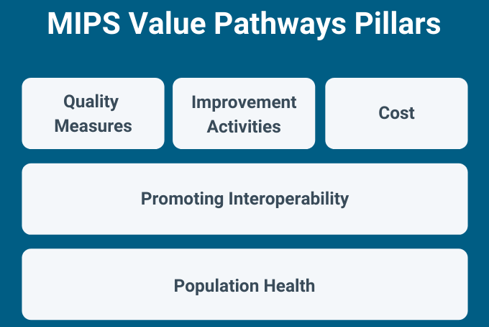
MIPS Value Pathways (MVPs) Do Not Yet Apply to Pathologists
Implementation started this year
Not all performance categories are applicable to pathologists
CMS vacillates on how – not whether– pathologists will participate in MVPs
It is not clear when the CMS will end traditional MIPS and force pathologists into MVPs
Notes:
Dr. Bocsi: As I described previously, the CMS has introduced a new reporting option or a new arm of the Quality Payment Program intended to serve as a transition between traditional MIPS and Advanced APMs. These are MIPS Value Pathways or MVPs. 2023 is the first year that MVPs are available for reporting. MVPs are intended to be a coherent set of activities, including Quality and Cost measures as well as Improvement Activities, that all focus on a single clinical topic. However, many of the elements of MVPs, including the Promoting Interoperability category and the current Population Health measures, do not apply to pathologists. Therefore, it remains unclear how pathologists will be able to meaningfully participate in MVPs. The CMS has been very clear in discussions with the CAP that they intend for all clinicians to eventually be in MVPs but the timeline and details of this as it relates to pathologists are unclear.
[Next slide]

Slide 33
MIPS Value Pathways (MVPs) Cover Many Specialties
2023 MVPs:
Advancing Care for Heart Disease
Advancing Cancer Care
Optimizing Chronic Disease Management
Advancing Rheumatology Patient Care
Improving Care for Lower Extremity Joint Repair
Adopting Best Practices and Promoting Patient Safety within Emergency Medicine
Patient Safety and Support of Positive Experiences with Anesthesia
Coordinating Stroke Care to Promote Prevention and Cultivate Positive Outcomes
Optimal Care for Kidney Health
Optimal Care for Patients with Episodic Neurological Conditions
Supportive Care for Neurodegenerative Conditions
Promoting Wellness
New MVPs for the 2024 performance year:
Focusing on Women’s Health
Quality Care for the Treatment of Ear, Nose, and Throat Disorders
Prevention and Treatment of Infectious Disorders Including Hepatitis C and HIV
Quality Care in Mental Health and Substance Use Disorders
Rehabilitative Support for Musculoskeletal Care
CMS combined Promoting Wellness and Optimizing Chronic Disease Management into one MVP
Notes:
Dr. Bocsi: The good news is that the CMS has not so far included pathologists in any MVPs. Here you can see the list of existing MVPs on the left and the 5 new MVPs that CMS finalized on the right. In addition, CMS combined two existing MVPs into one "Value in Primary Care MVP". While it is possible to see how pathologists might eventually participate in some of these MVPs, there are no pathology measures included in any MVP for 2024. The CAP continues to advocate to reduce burden on pathologists in MIPS while ensuring that pathologists are adequately recognized for the care they provide and the value they bring to the care team.
[Next slide]

Slide 34
CMS Agrees with CAP on Advanced Alternative Payment Model (APM) Determinations
Reminder: if an eligible clinician participates in an Advanced APM and achieves Qualifying APM Participant (QP) status, they are excluded from MIPS reporting
CMS remains "steadfast" in commitment to transition from traditional MIPS to Advanced APMs
As a result of CAP advocacy, CMS did not finalize a proposal to make Advanced APM QP determinations at the individual level
The CAP strongly opposed the proposal to switch to individual determinations as it could increase burden/complexity of the program for pathologists, and drive clinicians out of APMs
CMS agrees, noting concerns raised by commenters, and will continue to make these determinations at the APM Entity level for the 2024 performance period

Slide 35
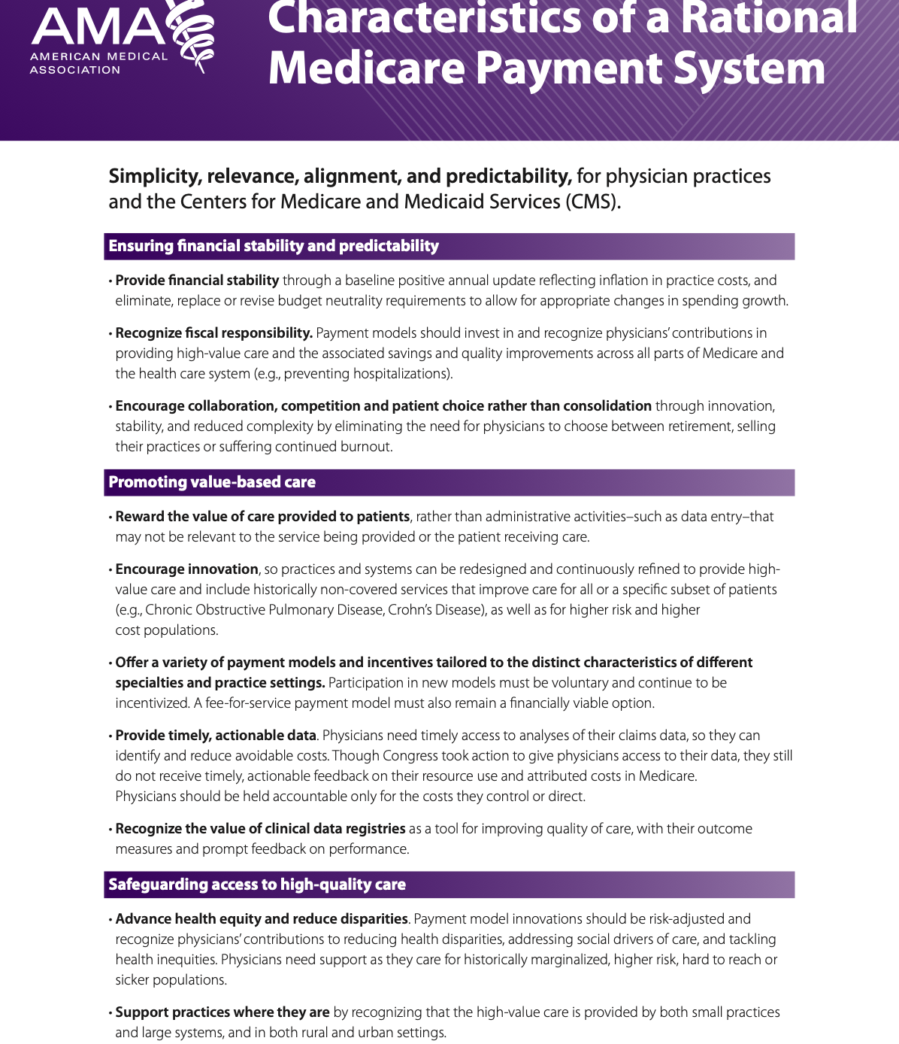
Protecting independent pathology practice is a high-level CAP principle
CAP continues to:
Advocate for the continuation of traditional MIPS for as long as possible
Engage in additional research on
Models for independent pathologists to engage in ACOs and APMs
Models for how pathologists participate in APMs
Advocate to reduce the burden of participation in MIPS and increase the positive payment incentives
Notes:
Dr Bocsi: The CAP remains in alignment with the AMA and dozens of other specialty societies when it comes to protecting independent practices and the right to practice medicine as doctors see fit. As part of this high-level principle, the CAP continues to advocate for maintaining traditional MIPS while also reducing the burdens associated with MIPS reporting. The CAP is also investigating meaningful ways that pathologists in independent practice can participate in ACOs and APMs without being forced to consolidate or merge with other practices.
[Next slide]

Slide 36
The CAP’s Pathologists Quality Registry Helps Our Members with MIPS
Practices in the registry get practice-specific advice on highest scoring measures for their situation.
Several choices for how to submit data for Quality Measures:
Manual data entry via web portal or excel file upload
Automated data entry with billing and/or LIS
Improvement Activities (IA):
The registry makes it easy to understand and choose from a subset of IA most pathologists are already doing
Even if you are facility-based, you still need to submit IA
Email us at MIPS@cap.org
Not sure how you're participating in MIPS? Visit https://qpp.cms.gov/participation-lookup and input your NPI to check your eligibility
Notes:
Dr. Bocsi: As part of the commitment to independent pathology practice, the CAP continues to develop and maintain pathology-relevant quality measures and improvement activities in the Pathologists Quality Registry. The Registry supports several mechanisms of data entry, including working with practices directly or billing companies to help maximize your score. We have excellent Registry staff who will talk with your practice to help you navigate MIPS to maximize your bonus potential. As scoring gets more complicated, it is increasingly important to understand how to score best. Most pathology practices can score best using the Pathologists Quality Registry and the quality measures it supports. For those of you who rely on your billing companies, we encourage you to ask them to reach out to the CAP on your behalf; the CAP’s QCDR measures should be an important part of their scoring strategy for you.
Contact CAP staff at mips@cap.org to understand the availability of higher-scoring measures and how to best report them.
I will now turn the over the presentation to Dr Saad for questions.
[Next slide]

Slide 37
Questions
Notes:
Dr. Saad: I will now ask Ms. Wright to read the first question.
Pam: Thank you Dr. Saad. We will now take questions. Please type your questions into the chat feature and we will answer them.
[[When there is one minute remaining, Pam will read the final question. After the final answer, Dr. Saad will close the program]].

Slide 38
Stay Informed Through the CAP
Follow CAP on social media
Twitter @CAPDCAdvocacy
Facebook.com/capathologists
Visit CAP.org > advocacy
Read Advocacy Update
Join PathNET, the CAP’s grassroots advocacy network
Notes:
[Begin to close the program … ] Dr. Saad: Please stay engaged and follow the C-A-P on social media
Our Twitter handle is @CAPDCAdvocacy
We are on at www.Facebook.com/capathologists
And we are also on LinkedIn
Visit CAP.org > advocacy section which has been recently updated and improved.
Read Advocacy Update every Tuesday and learn about the latest advocacy news and events
Finally please do join PathNET, the C-A-P’s grassroots advocacy network
[Next slide]

Slide 39
Notes:
Dr. Saad: That is all the time we have for today. If you have additional questions, please email AdvocacyUpdate@cap.org.
I want to thank our presenters for providing a thorough overview of the 2024 Medicare Policy and Payment Changes for Pathologists and the C-A-P’s advocacy on these issues.
And, on behalf of Dr. Bocsi, Dr. McLawhon, and CAP staff, I want to thank everyone for joining us and for your participation.
Thank you again and have a good day.

Slide 40
Appendix 2024 Digital Pathology Digitization Procedures
CPT Code | Long Descriptor
#+0827T | Digitization of glass microscope slides for cytopathology, fluids, washings, or brushings, except cervical or vaginal; smears with interpretation (List separately in addition to code for primary procedure) ▶(Use 0827T in conjunction with 88104)◀
#+0828T | Digitization of glass microscope slides for cytopathology, fluids, washings, or brushings, except cervical or vaginal; simple filter method with interpretation (List separately in addition to code for primary procedure) ▶(Use 0828T in conjunction with 88106)◀
#+0829T | Digitization of glass microscope slides for cytopathology, concentration technique, smears, and interpretation (eg, Saccomanno technique) (List separately in addition to code for primary procedure) ▶(Use 0829T in conjunction with 88108)◀
Notes:
Note: The new CPT Category III codes are add-on codes. Each code. CPT parenthetical instruction is included for each new CPT code.

Slide 41
Appendix 2024 Digital Pathology Digitization Procedures
CPT Code | Long Descriptor
#+0830T | Digitization of glass microscope slides for cytopathology, selective-cellular enhancement technique with interpretation (eg, liquid-based slide preparation method), except cervical or vaginal (List separately in addition to code for primary procedure) ▶(Use 0830T in conjunction with 88112)◀
#+0831T | Digitization of glass microscope slides for cytopathology, cervical or vaginal (any reporting system), requiring interpretation by physician (List separately in addition to code for primary procedure) ▶(Use 0831T in conjunction with 88141)◀ ▶(Do not report 0831T in conjunction with 88141, when digitization of glass microscope slides is performed using an automated, computer-assisted screening imaging system) ◀
Notes:
Note: The new CPT Category III codes are add-on codes. Each code. CPT parenthetical instruction is included for each new CPT code.

Slide 42
Appendix 2024 Digital Pathology Digitization Procedures
CPT Code | Long Descriptor
#+0832T | Digitization of glass microscope slides for cytopathology, smears, any other source; screening and interpretation (List separately in addition to code for primary procedure) ▶(Use 0832T in conjunction with 88160)◀
#+0833T | Digitization of glass microscope slides for cytopathology, smears, any other source; preparation, screening and interpretation (List separately in addition to code for primary procedure) ▶(Use 0833T in conjunction with 88161)◀
#+0834T | Digitization of glass microscope slides for cytopathology, smears, any other source; extended study involving over 5 slides and/or multiple stains (List separately in addition to code for primary procedure) ▶(Use 0834T in conjunction with 88162)◀
Notes:
Note: The new CPT Category III codes are add-on codes. Each code. CPT parenthetical instruction is included for each new CPT code.

Slide 43
Appendix 2024 Digital Pathology Digitization Procedures
CPT Code | Long Descriptor
#+0835T | Digitization of glass microscope slides for cytopathology, evaluation of fine needle aspirate; immediate cytohistologic study to determine adequacy for diagnosis, first evaluation episode, each site (List separately in addition to code for primary procedure) ►(Use 0835T in conjunction with 88172)◀ ▶(Do not report 0835T in conjunction with 88172, when 0837T is reported in conjunction with 88173)◀
#+0836T | Digitization of glass microscope slides for cytopathology, evaluation of fine needle aspirate; immediate cytohistologic study to determine adequacy for diagnosis, each separate additional evaluation episode, same site (List separately in addition to code for primary procedure) ▶(Use 0836T in conjunction with 88177)◀ ▶(Do not report 0836T in conjunction with 88177, when 0837T is reported in conjunction with 88173)◀
#+0837T | Digitization of glass microscope slides for cytopathology, evaluation of fine needle aspirate; interpretation and report (List separately in addition to code for primary procedure) ▶(Use 0837T in conjunction with 88173)◀
Notes:
Note: The new CPT Category III codes are add-on codes. Each code. CPT parenthetical instruction is included for each new CPT code.

Slide 44
Appendix 2024 Digital Pathology Digitization Procedures
CPT Code | Long Descriptor
#+0838T | Digitization of glass microscope slides for consultation and report on referred slides prepared elsewhere (List separately in addition to code for primary procedure) ▶(Use 0838T in conjunction with 88321)◀ ▶(Do not report 0838T in conjunction with 88321 for referred digitized glass microscope slides prepared elsewhere)◀
#+0839T | Digitization of glass microscope slides for consultation and report on referred material requiring preparation of slides (List separately in addition to code for primary procedure) ▶(Use 0839T in conjunction with 88323)◀ ▶(Do not report 0839T in conjunction with 88323 for referred digitized glass microscope slides prepared elsewhere)◀
#+0840T | Digitization of glass microscope slides for consultation, comprehensive, with review of records and specimens, with report on referred material (List separately in addition to code for primary procedure) ▶(Use 0840T in conjunction with 88325)◀ ▶(Do not report 0840T in conjunction with 88325 for referred digitized glass microscope slides prepared elsewhere)◀
Notes:
Note: The new CPT Category III codes are add-on codes. Each code. CPT parenthetical instruction is included for each new CPT code.

Slide 45
Appendix 2024 Digital Pathology Digitization Procedures
CPT Code | Long Descriptor
#+0841T | Digitization of glass microscope slides for pathology consultation during surgery; first tissue block, with frozen section(s), single specimen (List separately in addition to code for primary procedure) ▶(Use 0841T in conjunction with 88331)◀
#+0842T | Digitization of glass microscope slides for pathology consultation during surgery; each additional tissue block with frozen section(s) (List separately in addition to code for primary procedure) ▶(Use 0842T in conjunction with 88332)◀
#+0843T | Digitization of glass microscope slides for pathology consultation during surgery; cytologic examination (eg, touch preparation, squash preparation), initial site (List separately in addition to code for primary procedure) ▶(Use 0843T in conjunction with 88333)◀
#+0844T | Digitization of glass microscope slides for pathology consultation during surgery; cytologic examination (eg, touch preparation, squash preparation), each additional site (List separately in addition to code for primary procedure) ▶(Use 0844T in conjunction with 88334)◀
Notes:
Note: The new CPT Category III codes are add-on codes. Each code. CPT parenthetical instruction is included for each new CPT code.

Slide 46
Appendix 2024 Digital Pathology Digitization Procedures
CPT Code | Long Descriptor
#+0845T | Digitization of glass microscope slides for immunofluorescence, per specimen; initial single antibody stain procedure (List separately in addition to code for primary procedure) ▶(Use 0845T in conjunction with 88346)◀
#+0846T | Digitization of glass microscope slides for immunofluorescence, per specimen; each additional single antibody stain procedure (List separately in addition to code for primary procedure) ▶(Use 0846T in conjunction with 88350)◀
#+0847T | Digitization of glass microscope slides for examination and selection of retrieved archival (ie, previously diagnosed) tissue(s) for molecular analysis (eg, KRAS mutational analysis) (List separately in addition to code for primary procedure) ▶(Use 0847T in conjunction with 88363)◀ ▶(Do not report 0847T in conjunction 88363, when digitization of glass microscope slides has been previously reported)◀
Notes:
Note: The new CPT Category III codes are add-on codes. Each code. CPT parenthetical instruction is included for each new CPT code.

Slide 47
Appendix 2024 Digital Pathology Digitization Procedures
CPT Code | Long Descriptor
#+0848T | Digitization of glass microscope slides for in situ hybridization (eg, FISH), per specimen; initial single probe stain procedure (List separately in addition to code for primary procedure) ▶(Use 0848T in conjunction with 88365)◀
#+0849T | Digitization of glass microscope slides for in situ hybridization (eg, FISH), per specimen; each additional single probe stain procedure (List separately in addition to code for primary procedure) ▶(Use 0849T in conjunction with 88364)◀
#+0850T | Digitization of glass microscope slides for in situ hybridization (eg, FISH), per specimen; each multiplex probe stain procedure (List separately in addition to code for primary procedure) ▶(Use 0850T in conjunction with 88366)◀
Notes:
Note: The new CPT Category III codes are add-on codes. Each code. CPT parenthetical instruction is included for each new CPT code.

Slide 48
Appendix 2024 Digital Pathology Digitization Procedures
CPT Code | Long Descriptor
#+0851T | Digitization of glass microscope slides for morphometric analysis, in situ hybridization (quantitative or semiquantitative), manual, per specimen; initial single probe stain procedure (List separately in addition to code for primary procedure ▶(Use 0851T in conjunction with 88368)◀
#+0852T | Digitization of glass microscope slides for morphometric analysis, in situ hybridization (quantitative or semiquantitative), manual, per specimen; each additional single probe stain procedure (List separately in addition to code for primary procedure) ▶(Use 0852T in conjunction with 88369)◀
#+0853T | Digitization of glass microscope slides for morphometric analysis, in situ hybridization (quantitative or semiquantitative), manual, per specimen; each multiplex probe stain procedure (List separately in addition to code for primary procedure) ▶(Use 0853T in conjunction with 88377)◀
Notes:
Note: The new CPT Category III codes are add-on codes. Each code. CPT parenthetical instruction is included for each new CPT code.

Slide 49
Appendix 2024 Digital Pathology Digitization Procedures
CPT Code | Long Descriptor
#+0854T | Digitization of glass microscope slides for blood smear, peripheral, interpretation by physician with written report (List separately in addition to code for primary procedure) ▶(Use 0854T in conjunction with 85060)◀ ▶(Do not report 0854T in conjunction with 85060, when digitization of glass microscope slides is performed using an automated, computer-assisted cell morphology imaging analyzer)◀
#+0855T | Digitization of glass microscope slides for bone marrow, smear interpretation (List separately in addition to code for primary procedure) ▶(Use 0855T in conjunction with 85097)◀
#+0856T | Digitization of glass microscope slides for electron microscopy, diagnostic (List separately in addition to code for primary procedure) ▶(Use 0856T in conjunction with 88348)◀
Notes:
Note: The new CPT Category III codes are add-on codes. Each code. CPT parenthetical instruction is included for each new CPT code.

Slide 50
Appendix
Do not report the Category III codes:
Solely for archival purposes (eg, after the Category I service has already been performed and reported)
Solely for educational purposes (eg, when services are not used for individual patient reporting)
Solely for developing a database for training or validation of AI algorithms
Solely for clinical conference presentations (eg, tumor board interdisciplinary conferences)
Notes:
In addition to the 13 new codes, a new heading will be established in the Category III section along guidelines to define digital pathology digitization procedures.
Note that CPT instructs that Category III codes should not be reported:
solely for archival purposes (eg, after the Category I service has already been performed and reported)
solely for educational purposes (eg, when services are not used for individual patient reporting)
solely for developing a database for training or validation of AI algorithms
solely for clinical conference presentations (eg, tumor board interdisciplinary conferences)
Optional Discussion of other new CPT language.
“Digital pathology is a dynamic, image-based environment that enables the acquisition, management, and interpretation of pathology information generated from digitized glass microscope slides. Glass microscope slides are scanned by clinical staff, and captured images (either in real-time or stored in a computer server or cloud-based digital image archival and communication system) are used for digital examination for pathologic diagnosis distinct from direct visualization through a microscope.”
“Digitization of glass microscope slides enables remote examination by the pathologist and/or in conjunction with the use of artificial intelligence (AI) algorithms. Category III add-on codes 0751T-0763T may be reported in addition to the appropriate Category I service code when the digitization procedure of glass microscope slides is performed and reported in conjunction with the Category I code for the primary service.”
“Do not report the Category III codes in this subsection solely for archival purposes (eg, after the Category I service has already been performed and reported), solely for educational purposes (eg, when services are not used for individual patient reporting), solely for developing a database for training or validation of AI algorithms, or solely for clinical conference presentations (eg, tumor board interdisciplinary conferences).”

